Slide 1

Customer Shopping Behavior Analysis
Uncovering insights from 3,900 purchases to guide strategic business decisions.

Slide 2

Project Overview
Goal
Data Source
Analyze spending patterns, customer segments, product preferences, and subscription behavior.
Transactional data from 3,900 purchases across various product categories.
Outcome
Strategic insights for informed business decisions.

Slide 3
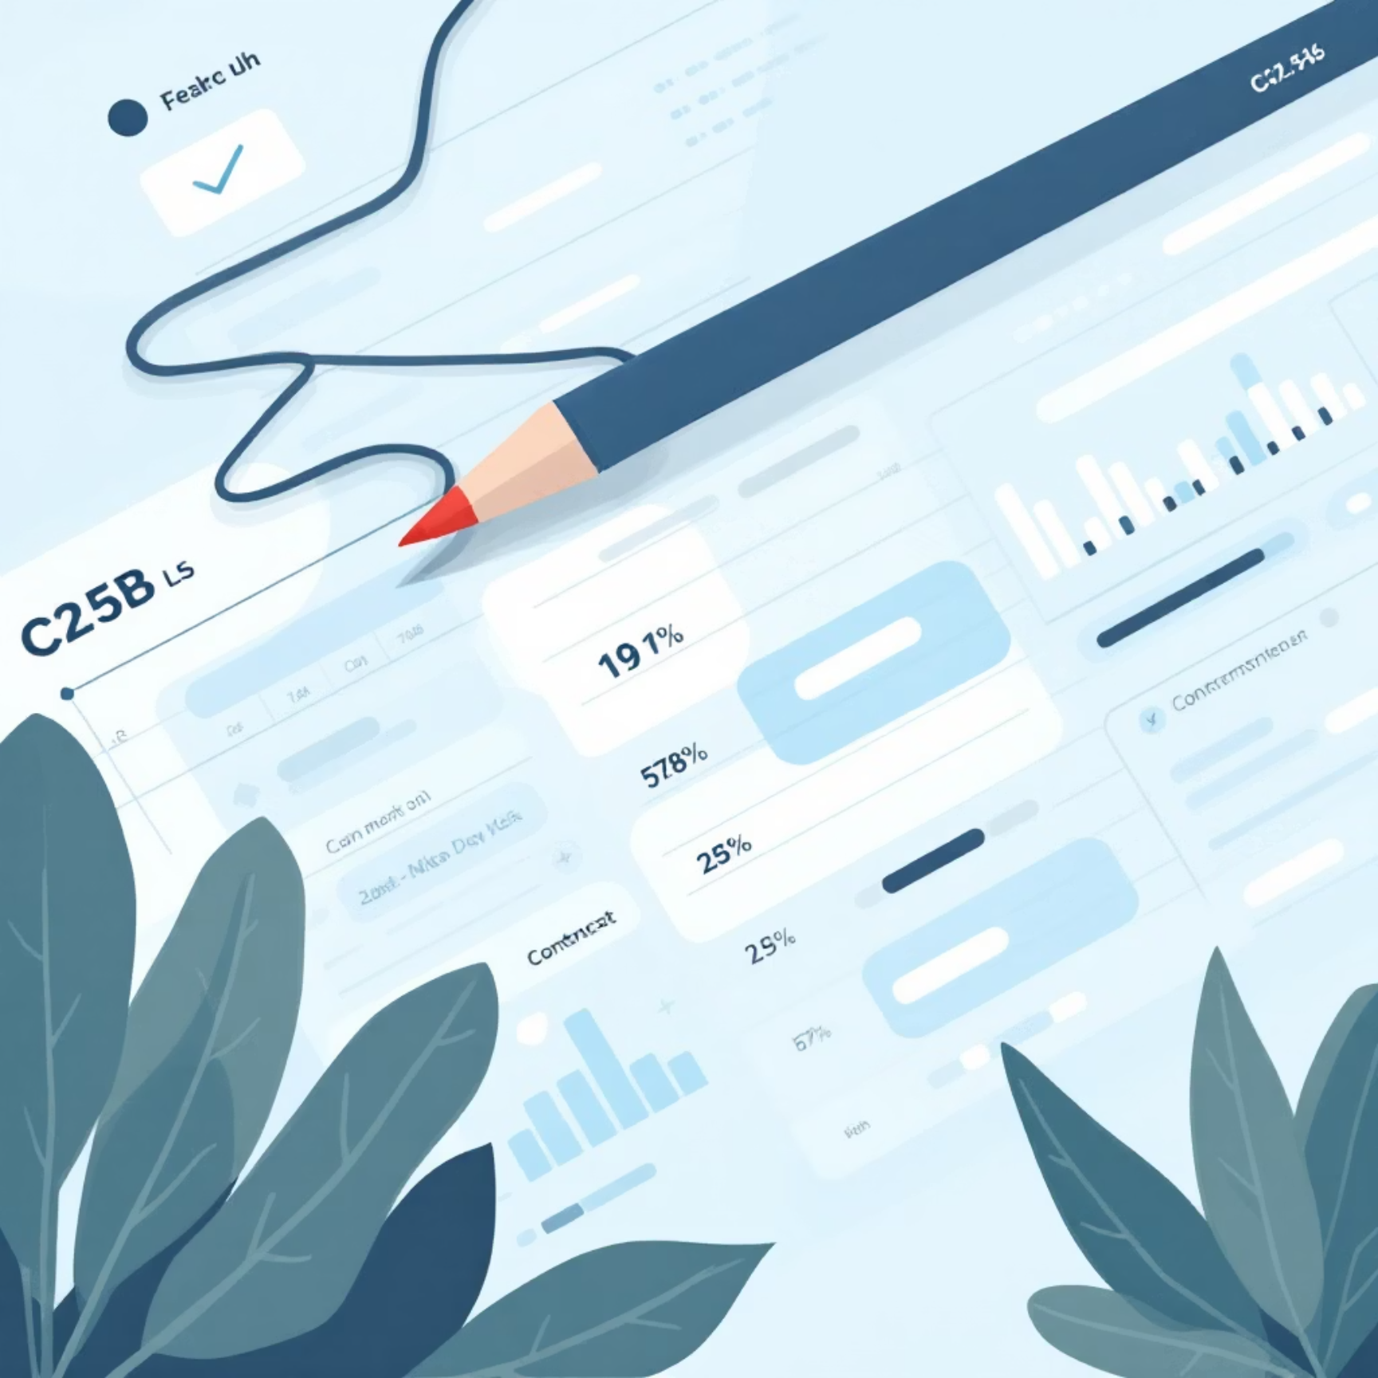
Dataset Summary
Key Features
Data Snapshot
Customer demographics (Age, Gender, Location, Subscription)
3,900 Rows, 18 Columns
Purchase details (Item, Category, Amount, Season, Size, Color)
Missing Data: 37 values in Review Rating
Shopping behavior (Discount, Promo, Previous Purchases, Frequency, Review, Shipping)

Slide 4

Exploratory Data Analysis (Python)
01
Data Loading & Exploration
Imported with pandas, checked structure and summary statistics.
02
Data Cleaning
Imputed missing 'Review Rating' with median, standardized column names.
03
Feature Engineering
Created 'age_group' and 'purchase_frequency_days'.
04
Database Integration
Loaded cleaned data into PostgreSQL for SQL analysis.

Slide 5
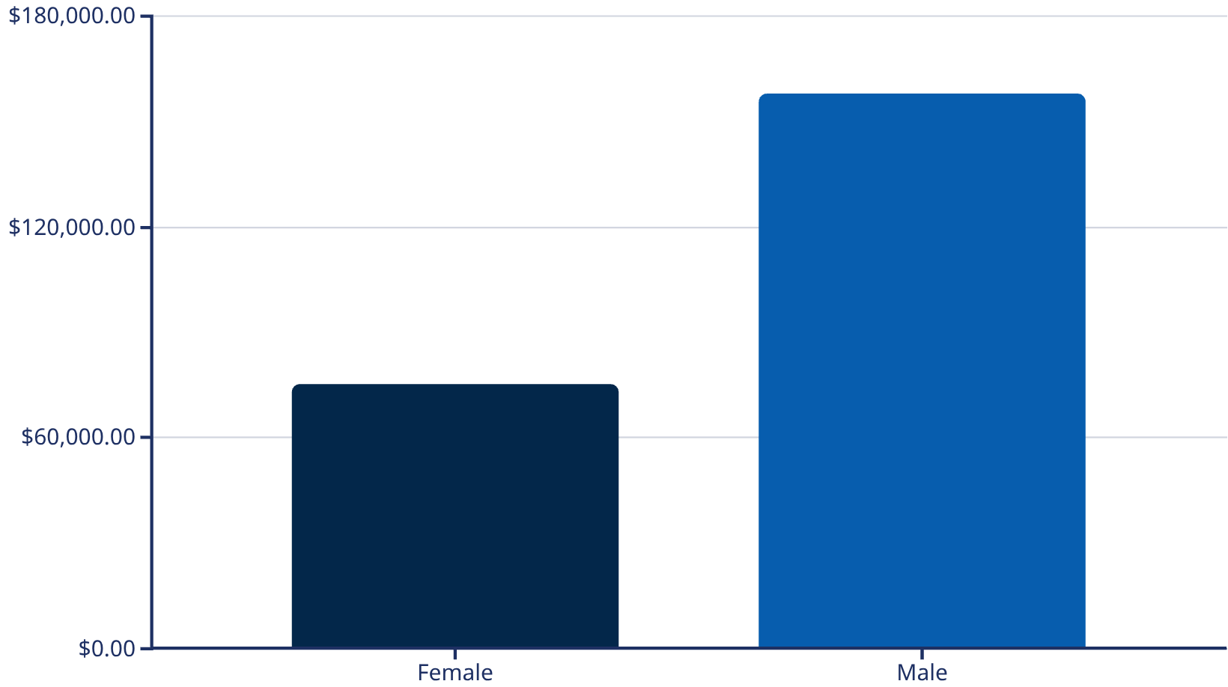
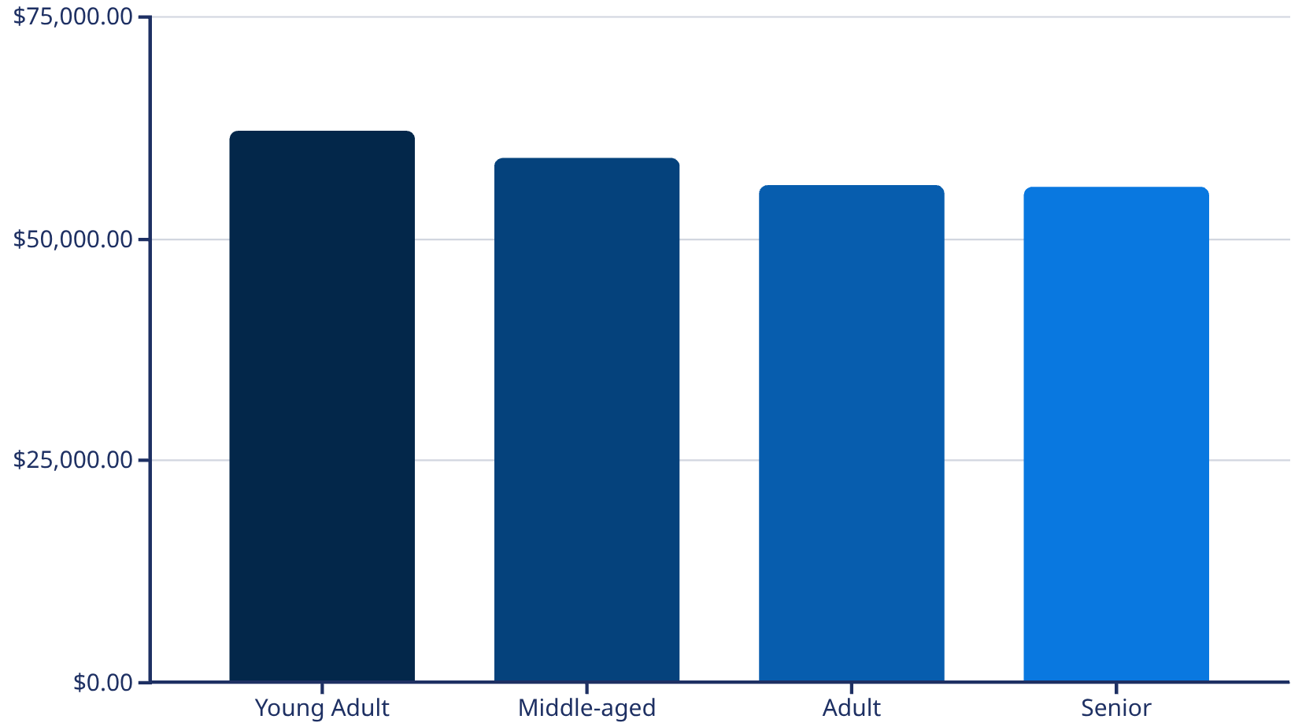
Revenue Insights by Gender & Age
Revenue by Gender
Revenue by Age Group
Male customers and young adults contribute significantly to overall revenue.

Slide 6
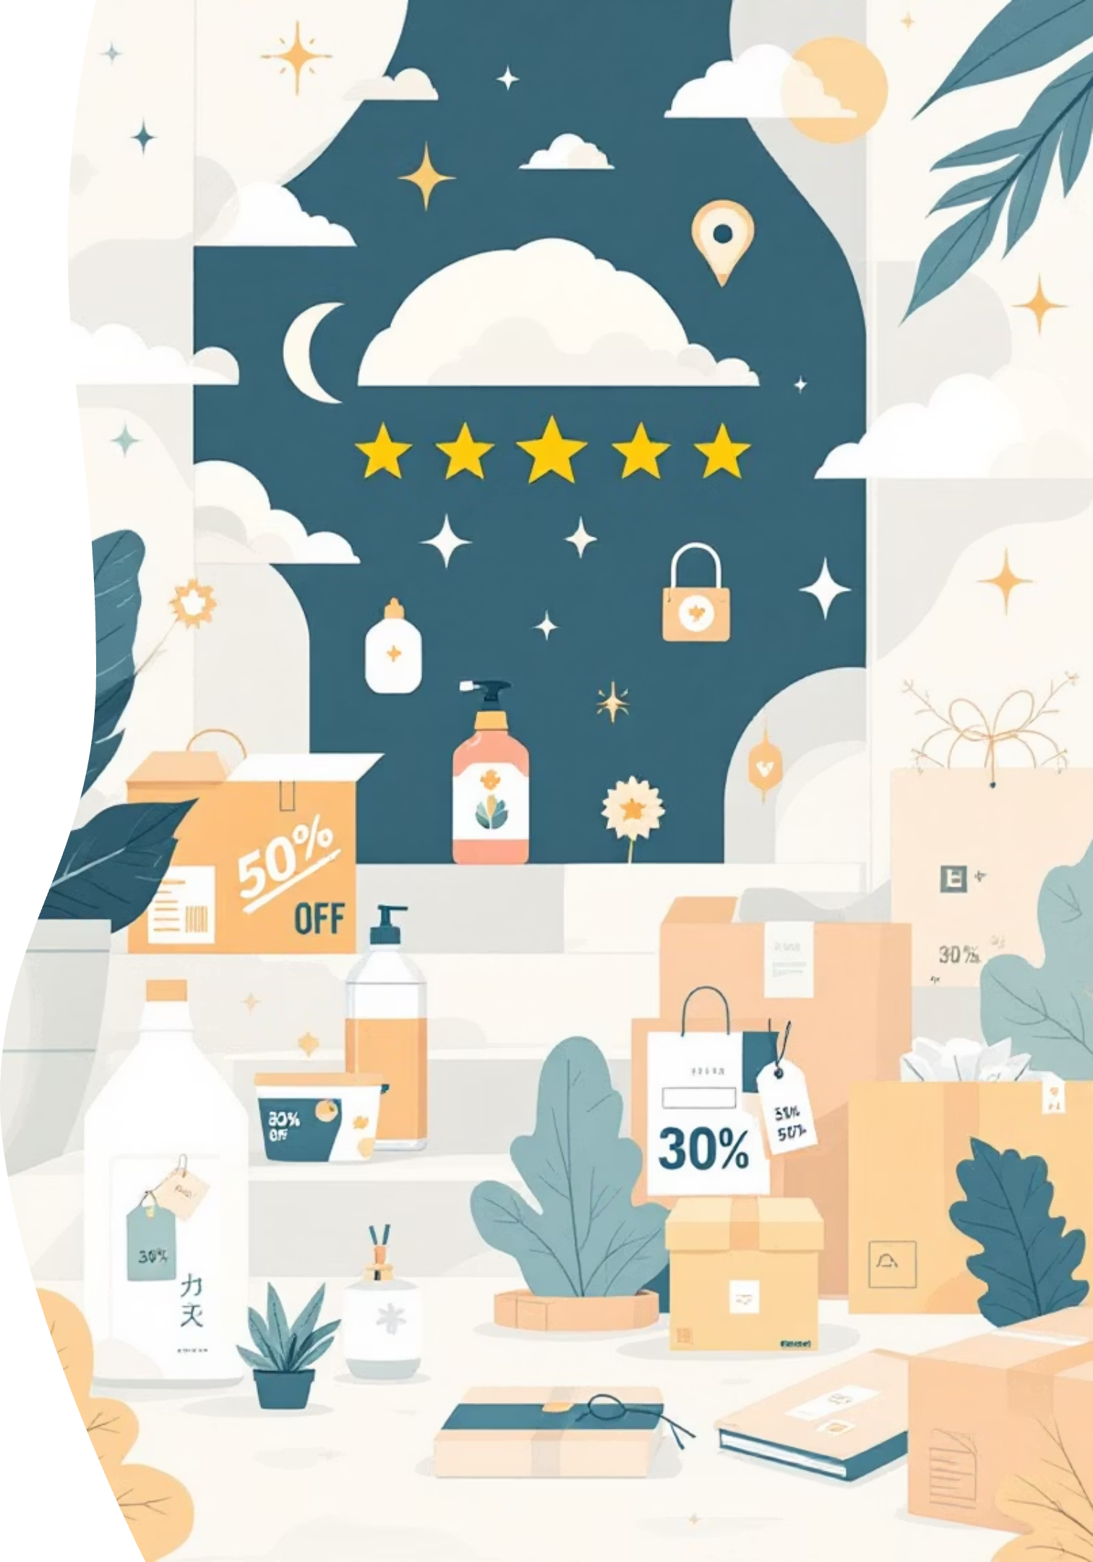
Product Performance & Shipping
1
2
Top 5 Products by Rating
Shipping Type Comparison
Gloves: 3.86
Sandals: 3.84
Standard: $58.46 avg.
Boots: 3.82
Express: $60.48 avg.
3
Discount-Dependent Products
Hat: 50% discounted
Sneakers: 49.66% discounted

Slide 7
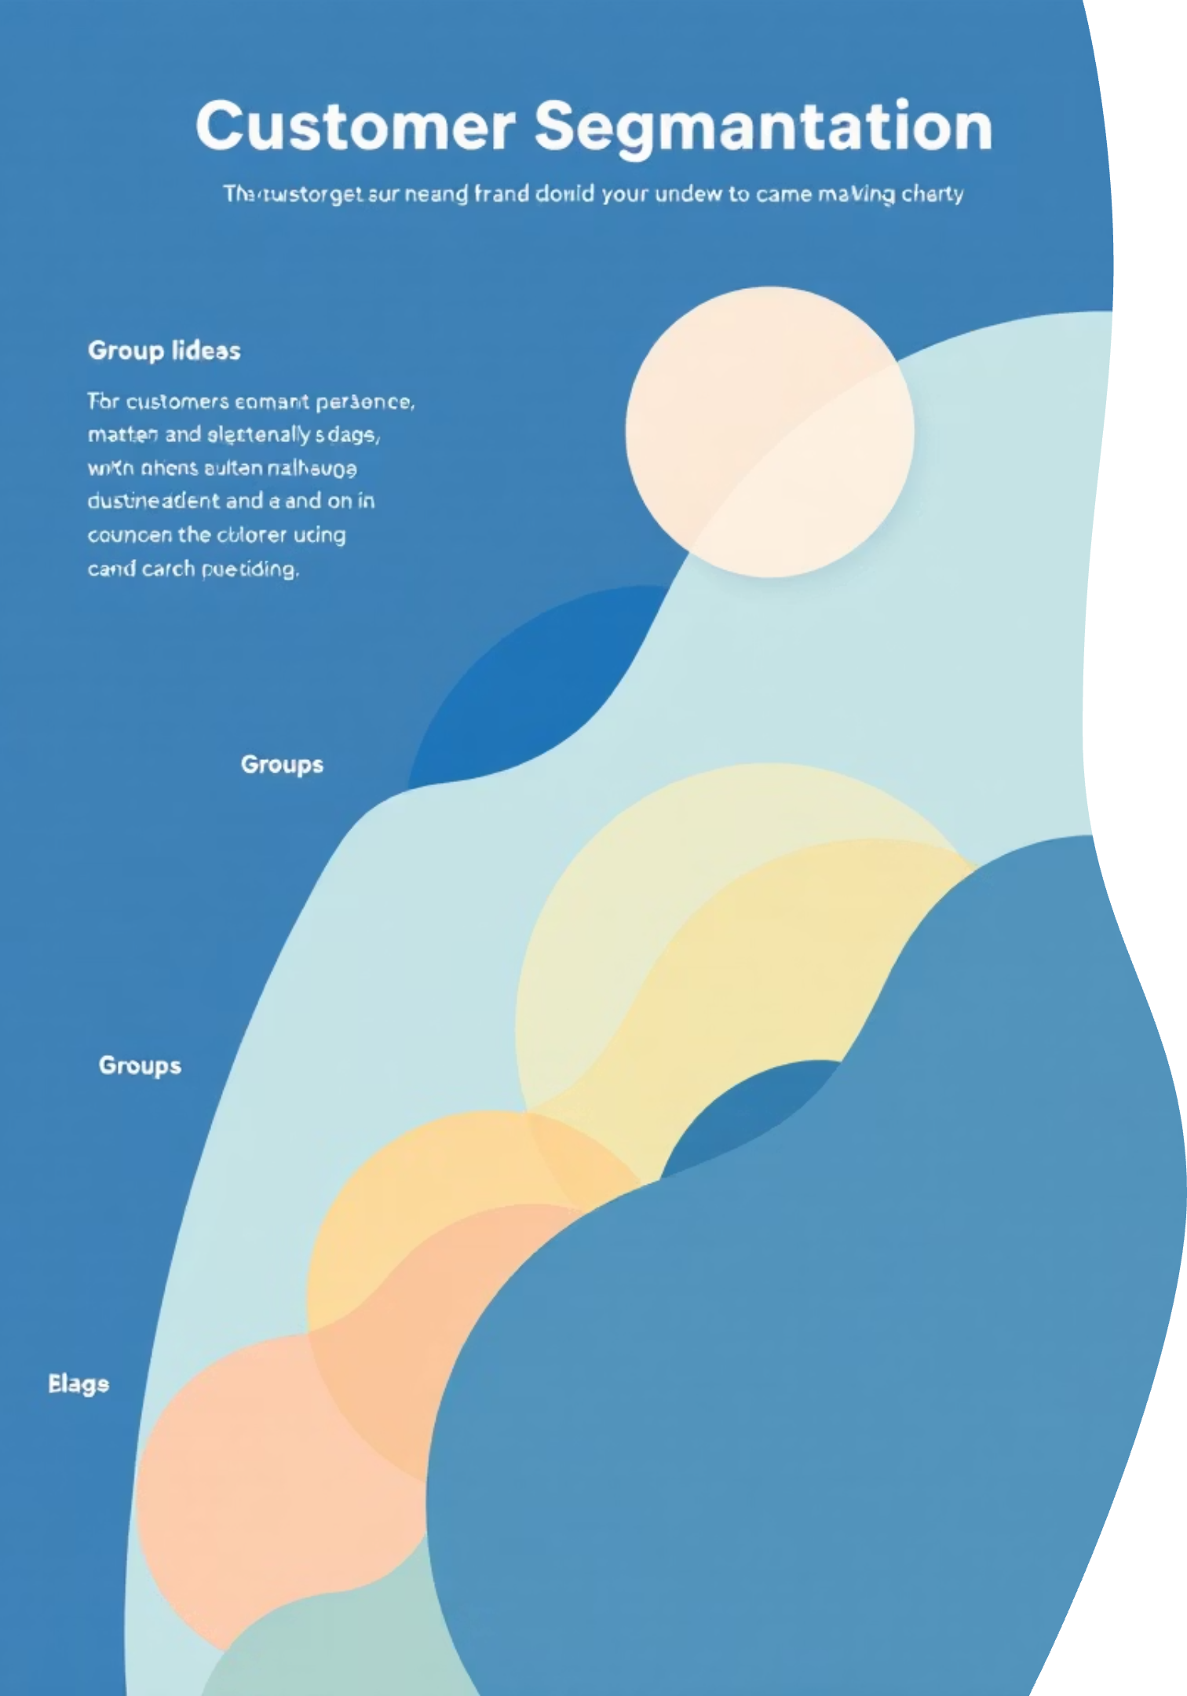

Customer Segmentation
Loyal
New
3116 Customers
83 Customers
Returning
701 Customers
Segmentation based on purchase history reveals a strong loyal customer base.

Slide 8

Subscription & Repeat Buyer Analysis
Subscribers vs. Non-Subscribers
Repeat Buyers & Subscriptions
Yes
1053
$59.49
$62,645
Customers with >5 purchases:
Non-Subscribers: 2518
No
2847
$59.87
$170,436
Subscribers: 958

Slide 9
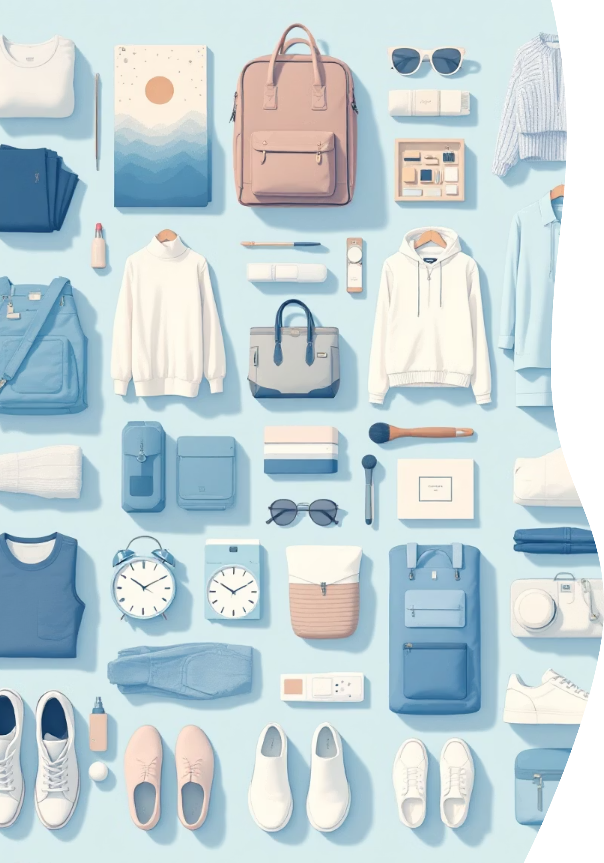
Top Products Per Category
Accessories
Jewelry (171)
Sunglasses (161)
Belt (161)
Clothing
Blouse (171)
Pants (171)
Shirt (169)
Footwear
Sandals (160)
Shoes (150)
Sneakers (145)
Outerwear
Jacket (163)
Coat (161)

Slide 10





Business Recommendations
Boost Subscriptions
Promote exclusive benefits.
Customer Loyalty
Reward repeat buyers.
Review Discount Policy
Balance sales with margin.
Targeted Marketing
Focus on high-revenue groups.

